Slide 1


🌻
| REVIEW 1
🌿
Online Gardening
& Community
Platform
Grow together: learn, plan and share your garden
🪴
Leader: Aman Raja -Add.No: 25SCSE1180058
1.Mohammad Sohail –Add.No: 25SCSE1180536
TEAM NAME: ZENBITS..
MEMBERS:
2.Raju Kumar - Add.No:25SCSE

Slide 2

WHAT IT DOES
⭐
Key Features
🔑
Sign Up / Login
🌿
Plant Catalog
🏡
My Garden
Secure account creation and authentication.
Search plants with sunlight, water and soil details.
Save plants and track their growth.
💧
Care Reminders
📸
Community Posts
💬
Comments & Likes
Watering and fertilizing alerts.
Share photos, tips and questions.
Interact with fellow gardeners.

Slide 3
TOOLS USED
💻
Technology Stack
☕
🗄️
🔗
Java (Swing)
MySQL
JDBC
Desktop user interface
Relational database
Java ↔ database link
System Workflow
Launch app
Login / Sign up
Load data (MySQL)
Browse, Post, Remind
Save to database

Slide 4
DESIGN
🧩
Class Diagram
Conn (JDBC → MySQL)
Login
Signup
Dashboard
PlantCatalog
Reminders
Community
Every screen class reuses Conn to run SQL queries through JDBC.

Slide 5
MYSQL TABLES
🗃️
Database Design
👤
users
🌱
plants
🪴
user_plants
user_id, name, email, password, city
plant_id, name, sunlight, water, soil
id, user_id, plant_id, planted_on
⏰
reminders
📝
posts
💬
comments
id, user_id, plant_id, task, due_date
post_id, user_id, title, content, date
comment_id, post_id, user_id, text

Slide 6
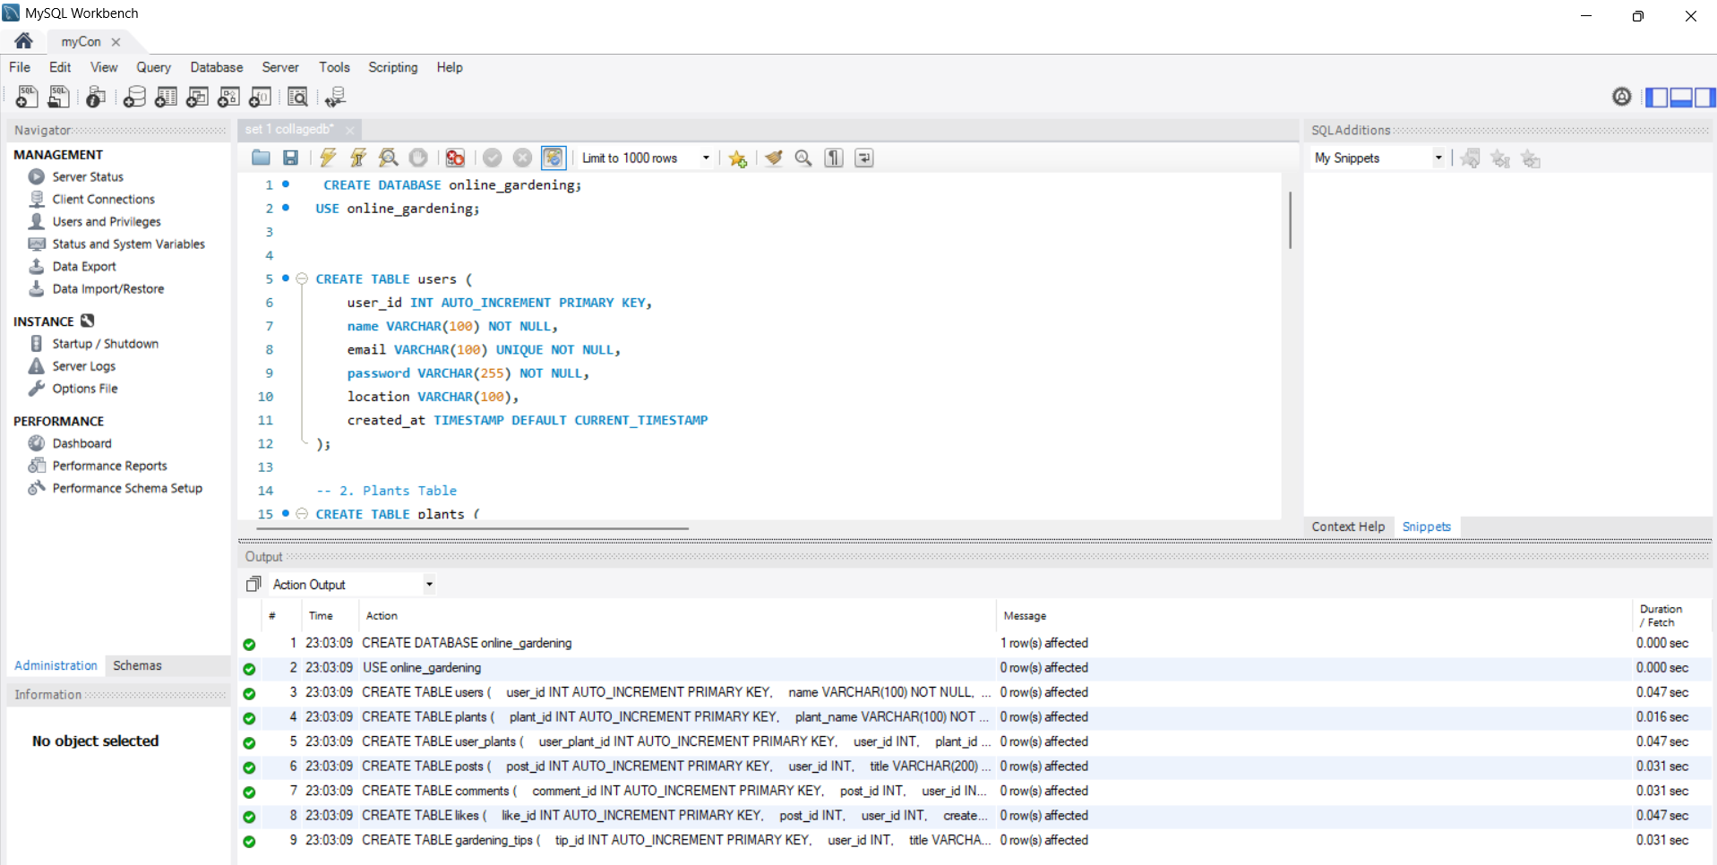
SCREENSHOTS
Visuals of Our Project
🖼️
MY SQL DATABASE:

Slide 7
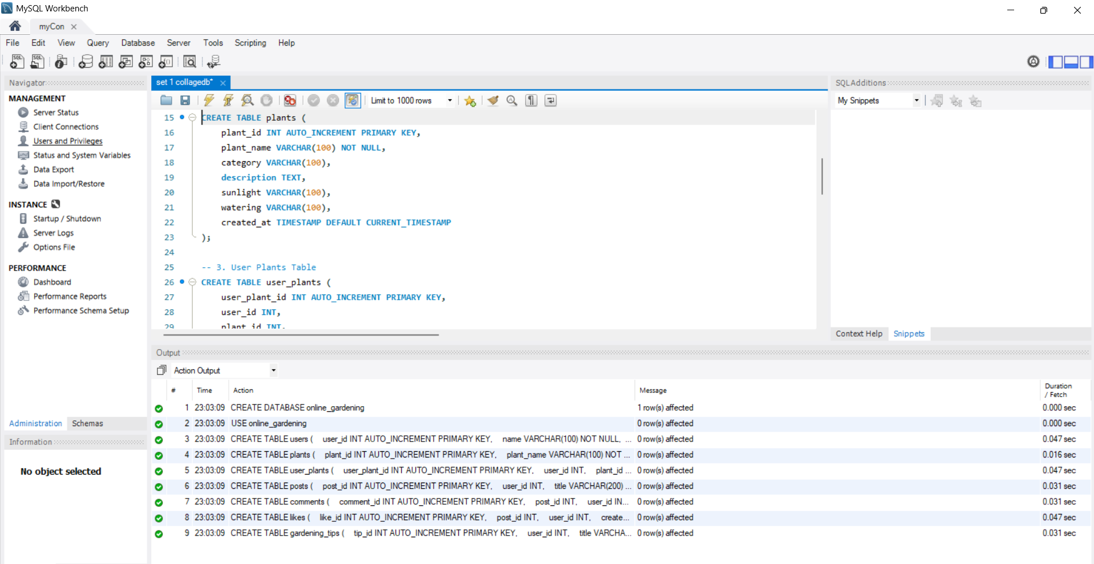
SCREENSHOTS
Visuals of Our Project
🖼️
MY SQL DATABASE:

Slide 8
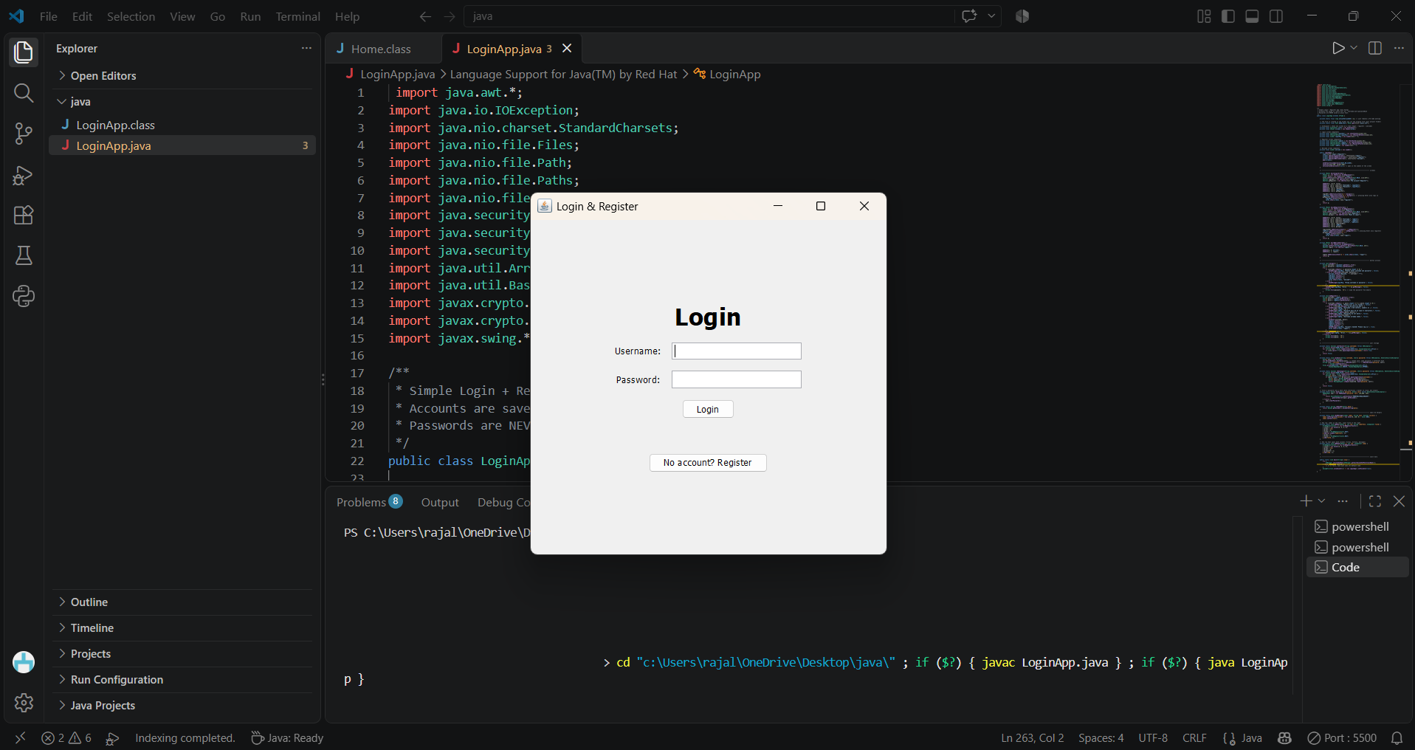
SCREENSHOTS
Visuals of Our Project
🖼️
Login page:

Slide 9
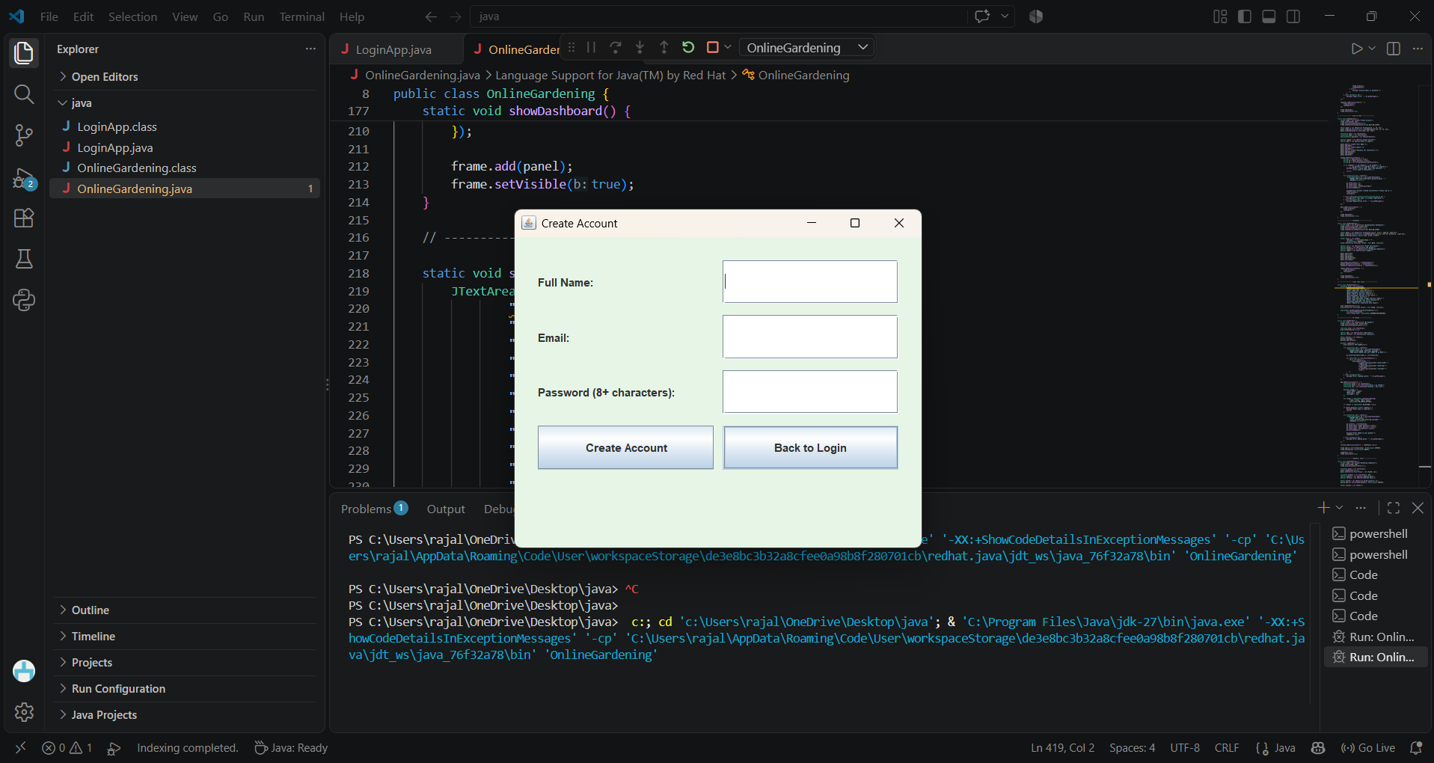
SCREENSHOTS
Visuals of Our Project
🖼️
sign up page:

Slide 10
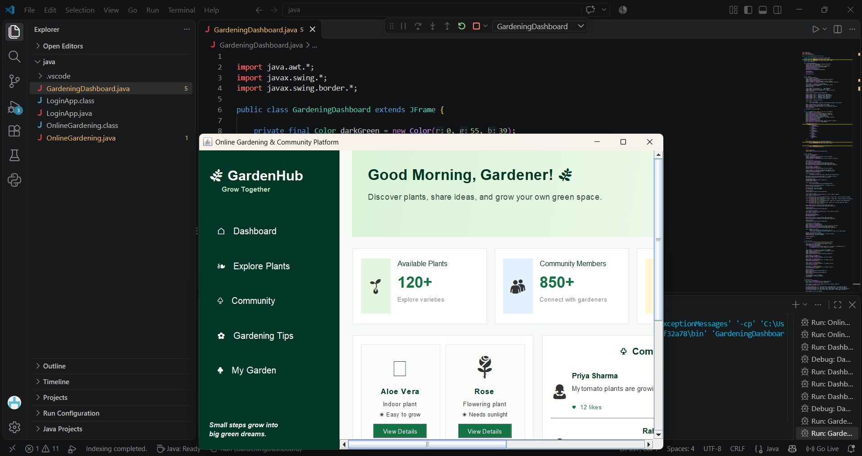
SCREENSHOTS
Visuals of Our Project
🖼️
DASHBOARD:

Slide 11
IMPACT
🚀
Benefits & Future Scope
🌍
Benefits
🔮
Future Scope
• Saves time with one-stop plant info
• Healthier plants through timely care
• Encourages eco-friendly urban gardening
• Builds a helpful local community
• Mobile app and web version
• AI plant disease detection from photos
• Weather-based watering alerts
• Marketplace for seeds and tools

Slide 12
🌻
Thank You
Questions & Feedback Welcome
Online Gardening & Community Platform

